Slide 1
Lanthanide doping

Slide 2
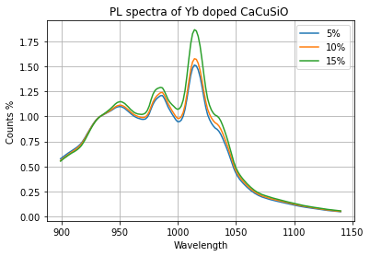

$$Ca_{1−x}CuSi_{4}O_{10}:Yb_{x}$$
Stong candidate
High fluorescence
High temperature dep.
Very narrow gaps

Slide 3
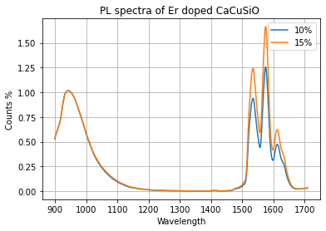

$$Ca_{1−x}CuSi_{4}O_{10}:Er_{x}$$
Strong candidate
High fluorescence
Temperature dependent
High setup dependence
SHG

Slide 4
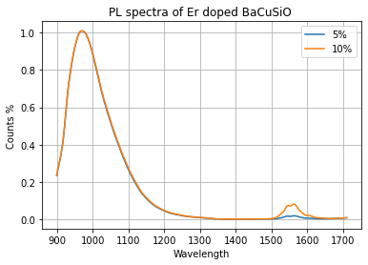

$$Ba_{1−x}CuSi_{4}O_{10}:Er_{x}$$
Weak dopand contribution

Slide 5
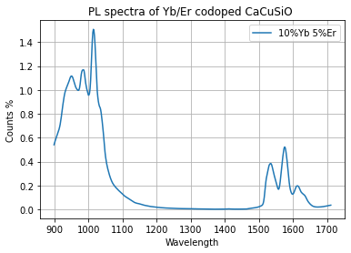

$$Ca_{1−(x+y)}CuSi_{4}O_{10}:Yb_{x}Er_{y}$$
Promising Candidate
High fluorescence
TBC

Slide 6
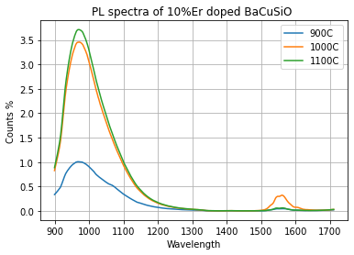

Temperature dependence of $$Ba_{1−x}CuSi_{4}O_{10}:Er_{x}$$
Erbium seams to dislike 1000+C

